Slide 1

SWE 312: Theory of Computing
SWE 312- Lecture 02
Fatama Binta Rafiq (FBR)
Lecturer, Department of Software Engineering

Slide 2
How you will be assessed:
Attendance: 07 marks
Assignment: 05 marks
Quiz: 15 marks
Mid Term: 25 marks
Presentation: 08 marks
Final: 40 marks
Total: 100 marks

Slide 3
Objectives:
It comprises the fundamental mathematical properties of computer hardware, software and certain application .
The subject has obvious connections with engineering practice, and, as in many sciences.
Theory has proved its value to other parts of computer science. Many technologists and companies grew up out of the work of theorists.
It deals with the definitions and properties of mathematical models of computation.

Slide 4
Learning Outcome:
At the end of the course student will able to learn Finite Automata, Deterministic Finite Automata (DFA); Non-deterministic Finite Automata (NFA), Context free languages; Context free grammars; Turing Machines and its functionality.
Finite automata, is used in text processing, compilers, and hardware design.
Another model, called the context-free grammar, is used in programming languages and artificial intelligence.

Slide 5
Course Content:
  Introduction
  Finite Automata
  Deterministic Finite Automata (DFA)
  Non-deterministic Finite Automata (NFA)
  Conversion of NFA to DFA
  Regular Expression
  Pushdown Automata
  Context free languages

Slide 6
Course Content:
  Context free grammars
  Turing Machines:
    basic machines
    configuration
    computing with Turing machines
    combining Turing machines

Slide 7
Resources:
Text Book:
SIPSER, M. Introduction to the Theory of Computation, 2nd ed. Course Technology, 2005.
LEWIS, H. R., AND PAPADIMITRIOU, C. H. Elements of the Theory of Computation, 2nd ed. Pearson Education Asia, 2001.
HOPCROFT, J. E., MOTWANI, R., AND ULLMAN, J. D. Introduction to Automata Theory, Languages, and Computation, 3rd ed.

Slide 8
Topics:
Introduction
Automata Theory
Symbols and alphabet
Language
Sets
Function
Implication
Valid/invalid computation

Slide 9
Theory of Computation (ToC):
What is Computation?
Ans: Computation is calculation, solving, making decision or any task done by computer/calculator/ any machine.
What is Theory?
Ans: The term Theory defines capabilities, limitations of those machines.
Purpose of the Theory of Computation:
“Develop formal mathematical models of computation that reflect real-world computers.”

Slide 10
Automata Theory:
Automata theory deals with the definitions and properties of mathematical models of computation.
These models play a role in several applied areas of computer science.
Finite automata, is used in text processing, compilers, and hardware design.
Another model, called the context-free grammar, is used in programming languages and artificial intelligence.
Automata theory is an excellent place to begin the study of the theory of computation.

Slide 11
Mathematical Terminology:
Symbol:
Symbol is the basic building block of ToC.
Example: Can be anything like: a,b,c,A,B,Z,0,1,…etc
Alphabet:
An alphabet is a finite set of symbols.
We use the symbol ∑ (sigma) to denote an alphabet.
Examples:
∑ = {0,1} : Binary alphabet
  ∑ = {A~Z, 0~9} : Alphanumeric alphabet
  ∑ = {a,b,c, ….,z} : Alphabet of small letters

Slide 12
Mathematical Terminology:
String:
A string or word is a finite sequence/group of symbols chosen from the alphabet (∑)
Examples:
01011 = is a string from the binary alphabet ∑{0,1}
abacbc = is a string from the alphabet ∑{a, b, c}
3786 = is a string over {0,1,2,3,4,5,6,7,8,9}
Empty string is the string with no symbols, denoted by ε (epsilon) or λ
Length of a string, denoted by |w|, is equal to the number of symbols/characters in the string

Slide 13
Mathematical Terminology:
Example:
w = classroom |w| = 9
w = 010100 |w| = 6
  w = ε |w| = 0
The position of a symbol in a string is denoted by (w)
Example: w = classroom
  w(3) = a, w(4) = s, w(5) = s
Concatenation of strings:
x = abc, y = pqr
Concatenation of x and y:
x◦y (or xy) = abcpqr

Slide 14
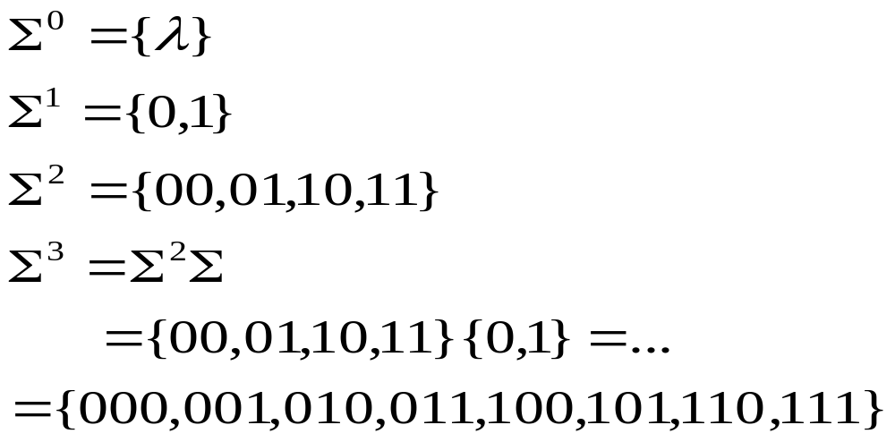
Mathematical Terminology:
  Power of Alphabet:
  If ∑ is an alphabet, then, ∑^{k} = is the set of all strings of length k.
  Example: Let, ∑ = {0,1}, then

Slide 15
Mathematical Terminology:
Language:
Language is a set of strings chosen from the alphabet ∑
Language L could be finite or infinite
Example: Suppose ∑ = { a,b }
L1 = Set of all strings of length 2
= { aa, ab, ba, bb } [Finite]
L2 = Set of all strings of length 3
= { aaa, aab, aba, abb, baa, bab, bba, bbb }[Finite]
L3 = Set of all strings where each string starts with “a”
= { a, aa, ab, aaa, aab, aba, abb,…….. } [Infinite]

Slide 16
Mathematical Terminology:
Set:
A set is a collection of elements.
To indicate that x is an element of the set S, we write x ∈ S
The statement that x is not in S is written as x ∉ S.
Example:
The set of all natural numbers 0,1,2.. is denoted by
N = {0,1,2,3,... }
When the need arises, we use more explicit notation, in which we write S = { i ≥ 0, i is even };We read this as “S is the set of all i, such that i is greater than zero, and i is even.“

Slide 17
Mathematical Terminology:
SEQUENCES AND TUPLES:
A sequence of objects is a list of these objects in some order.
For example, the sequence 7, 21, 57 would be written
(7, 21, 57)
Finite sequences often are called tuples.
A sequence with k elements is a k-tuple. Thus (7,21, 57) is a 3 -tuple. A 2-tuple is also called a pair.

Slide 18
Mathematical Terminology:
Cartesian product or cross product:
If A and B are two sets, the Cartesian product or cross product of A and B, written A x B
If A = {1, 2} and B {x, y, z},
A x B = { (1, x), (1, y), (1, z), (2, x), (2, y), (2, z) }.

Slide 19
Implication:
So the question is where we use those theorem, idea for computation?
Just consider a simple C Programming language.
# void main ()
{
  int a,b;
  etc;
  etc;
  }
  C programming language = Set of all “valid” program

Slide 20
Valid / Invalid Computation:
Let us consider an example, where a string is given and have to calculate that the string is present in the language or not ?
Given, L is a Finite language;
∑ = { a, b }
L1 = { aa, ab, ba, bb }
String, S = aaa
Here, S = aaa is not present in the language and we can calculate this and thus is invalid operation for computation.

Slide 21
Valid / Invalid Computation:
Let us consider another example, where a string is given and have to calculate that the string is present in the language or not ?
Given, L is a infinite language;
∑ = { a, b }
L2 = { a, aa, aaa, ab, aab, abb,…. }
String, S = baba
Here, S = baba will not be present in the language So this is an example of invalid operation for computation.

Slide 22
Thank You !!!
Any Questions ???

